Slide 1

Sialens Wythnosol Cymraeg
Weekly Welsh Challenge
Wythnos 1

Slide 2

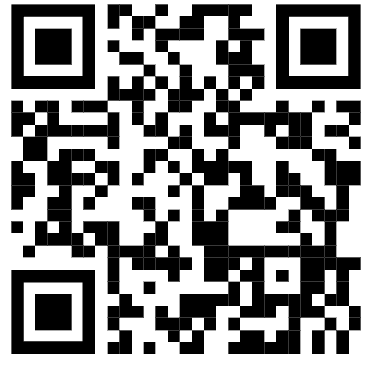
Cân yr Wythnos
Song of the week
Tesni Hughes - Cwestiynau
Scan the QR code to learn more about Tesni Hughes/ Sganiwch y cod QR i ddysgu mwy am Tesni Hughes.
https://www.youtube.com/watch?v=U5xmaJHdGVI&ab_channel=Lwp

Slide 3

Termau yr wythnos
Terms of the week
Practise your numbers in Cymraeg!
un | one | un deg un | eleven
dau | two | un deg dau | twelve
tri | three | un deg tri | thirteen
pedwar | four | un deg pedwar | fourteen
pump | five | un deg pump | fifteen
chwech | six | un deg chwech | sixteen
saith | seven | un deg saith | seventeen
wyth | eight | un deg wyth | eighteen
naw | nine | un deg naw | nineteen
deg | ten | dau ddeg | twenty
Can you make a list of numbers from 20 to 30?

Slide 4

Sialens yr Wythnos
Challenge of the week
Answer the following sums in Cymraeg.
1) | 2 | + | 5 | = | _________
2) | 10 | - | 1 | = | _________
3) | 3 | × | 4 | = | _________
4) | 20 | ÷ | 2 | = | _________
5) | 2 | + | 3 | = | _________
6) | 19 | - | 1 | = | _________
7) | 4 | × | 5 | = | _________
8) | 16 | ÷ | 4 | = | _________
dau ddeg
un deg dau
pump
pedwar
saith
deg
un deg wyth
naw

